Slide 1

MAJOR PROJECT REPORT
ON
Blockchain Voting App
Submitted by
Vipin Kumar Dinkar 03916404517
Under the supervision of
Dr. M. Bala Krishnan Associate Professor
in partial fulfilment of the requirement for the award of degree of
MASTER OF COMPUTER APPLICATION IN
SOFTWARE ENGINEERING
University School of Information, Communication & Technology, Guru Gobind Singh Indraprastha University, New Delhi.
Jan-May, 2020

Slide 2
Table of Contents
1. Abstract
11. Simulation
2. Introduction
12. Screenshots
3. Problem Statement
13. Analysis of transactions
4. Motivation
14. Limitation
5. Objective
6. SDLC
15. Comparison to traditional System
7. FlowChart
16. Conclusion
16. Conclusion
8. DFD
9. Hardware and Software Requirements
17. Future Work
10. POW vs POS
18. References

Slide 3
Abstract
We live in a country where we have democracy that’s why we have a voting right. We can choose any candidate of our choice. In India we use EVM (Electronic Voting Machine) [4]
In place of paper. We thought that digitalizing the process of voting will help us in removing corruption and fraudulent activities and we were in a impression that it happened.
But in a demo [3] by APP (Aam Admi Party) in 2017 assembly, showed us that we are wrong. Evm are easily hackable hence, our voting right is used wrongly.
Here comes a new era of Decentralized networks, Cryptocurrency which ensures that no transaction can be hacked or modified since it goes thought all the nodes for verification.[13]
So why don’t we use it as it provides security as the hash will require tremendous amount of time before we can manipulate it. The blockchain network as it is not owned by any single organization can be prone to 51% attack. Still the incentive is far greater than the outcoming.

Slide 4
Introduction
Blockchain
The blockchain is a like a immutable linked list which records every transaction happens.
The blocks are added to blockchain in a sequential and linear. The blockchain network have all the information from the origin (genesis) block to the latest block and can traverse easily
without any cost. The reads on the blockchain are free but writes cost (GAS)[2] Every Block is immutable so when a block is generated it can’t be modified.
Ethereum
Ethereum is a global, open-source platform for decentralized applications.
On Ethereum, you can use JS or solidity to write smart contracts [1] to interact with the blockchain. It’s one of the finest blockchain platform available to make dapps.
Smart Contracts
It is an auto executing piece of code or contract which functions only when certain conditions are met. It lives in the middleware of every blockchain.

Slide 5
Ganache
It is an opensource local blockchain tool created for development and testing. It works exactly like a real blockchain and provides handy tools such as project imports, transaction display etc.
Solidity
It is a restricted ,object oriented ,high-level language based on JavaScript,C++ and python and is designed to target the Ethereum Virtual Machine (EVM). It is used to create smart contract which executes on the blockchain[10].
JavaScript
It is a light weight client scripting language to make webpage dynamic. Its syntax is similar to its parent java but provides few inbuilt functions which are related to web-based interaction. Since JavaScript is interpreted it doesn’t require time in compiling hence fast.

Slide 6
Bootstrap
It is a light weight CSS framework with grid system that allows the modification of the HTML elements on the fly with no cost to the service. It also a client-side framework. Its ideal ology is build once run everywhere.
CSS
CSS stands for cascading styled sheet. It adds styling to the plain html elements so that they look more pleasing to the eye. With it we are able to create sites with eye catching animations and effects.

Slide 7
Problem Statement
All the existing voting systems lack security, transparency and efficiency.[13] When we vote for a candidate we don’t know if our vote is casted to him or not. Also, humans have a tendency to do bad things under pressure of money, power and greed. We need a fool proof system which provides us a guarantee and cost less than the previous one as the Evms needs maintenance and regular security check-up and transportation and storage cost .[9]
The cost of transferring evms back and forth from the storage location to polling centers is also significant. And who knows what happens when the transfer of the evms begins after the polling.

Slide 8
Motivation
The reason for learning blockchain was to increase my knowledge about it. How they function, why blockchain is the new standard of managing transactions. Since everything in today’s modern world is a transaction. We innovated our way from file system to database then SQL databases to NOSQL databases for enhanced upscaling. But we didn’t do much in regards of improving the security of them. We can you blockchain just like database. Unlike most of the database which are centralized it works of the opposite technology.
I was amazed by learning the fact about decentralization and how it provides transparency.

Slide 9
Objective
This project will solve the problem of security and fix any fraudulent activity. Blockchain is
paving the way for a direct democracy. The rules of political parties and the elections needs to be changed so that they can be transparent and support blockchain environment.
We can show super-fast results after elections are done since all the blocks are connected, we
can run query and visualize the data and find the winning candidate within minutes or even seconds. This app will gain confidence as everything is transparent and immutable after being created (vote casted). This app will cost less than the traditional EVM [4] and the cost of the people for security and transport. It is the true digital version of the voting process.

Slide 10
SDLC Model
This I have used AD HOC (build and fix) model [6], since I was alone in the project I have all the control over the project.At first I was using IBM’s blockchain platform( Hyperledger)[7] but it was very restrictive , it was difficult to find the solutions of the bugs ,then I made my switch to Ethereum Virtual Machine. I made several revisions of the project and used git for version controlling. I knew what I wanted and got it right. Except the Aadhaar api[8] connectivity. Which is pending and due to corona virus its stopped.

Slide 11
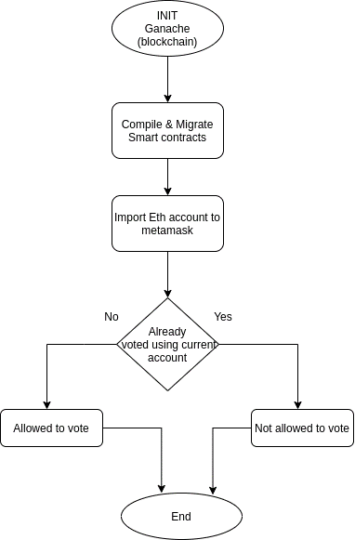
Flow Chart
This flowchart shows the sequential flow of the dapp. From initial state to the final state.

Slide 12
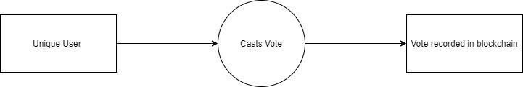
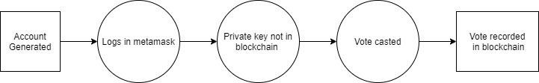
Data Flow Diagram
Level 0
Level 1

Slide 13
Hardware and Software Requirements
SOFTWARE REQUIREMENT:
Web Browser: Chrome, Firefox, Safari
MetaMask: Extension to convert browser into blockchain browser
Truffle.js: A opensource blockchain framework for Ethereum based network
Web3.js: It act as a interface between a eth node and browser over http.
Node: It is a opensource runtime environment which allows a js code to be executed outside the web browser.
Ganache: One click blockchain (Local) tool which also generates accounts with fake Ether
Code Editor: Vs code, Sublime, Atom etc.
jQuery: A fast, small and feature rich JS library.
HARDWARE REQUIREMENT:
RAM: 2GB or more
Processor: 1.2 GHz or Higher Processor
Storage: 100GB or more live free space on server
Screen resolution: minimum 1024x768
Sound Peripheral: headphones, speakers
Internet: 512kbps min

Slide 14
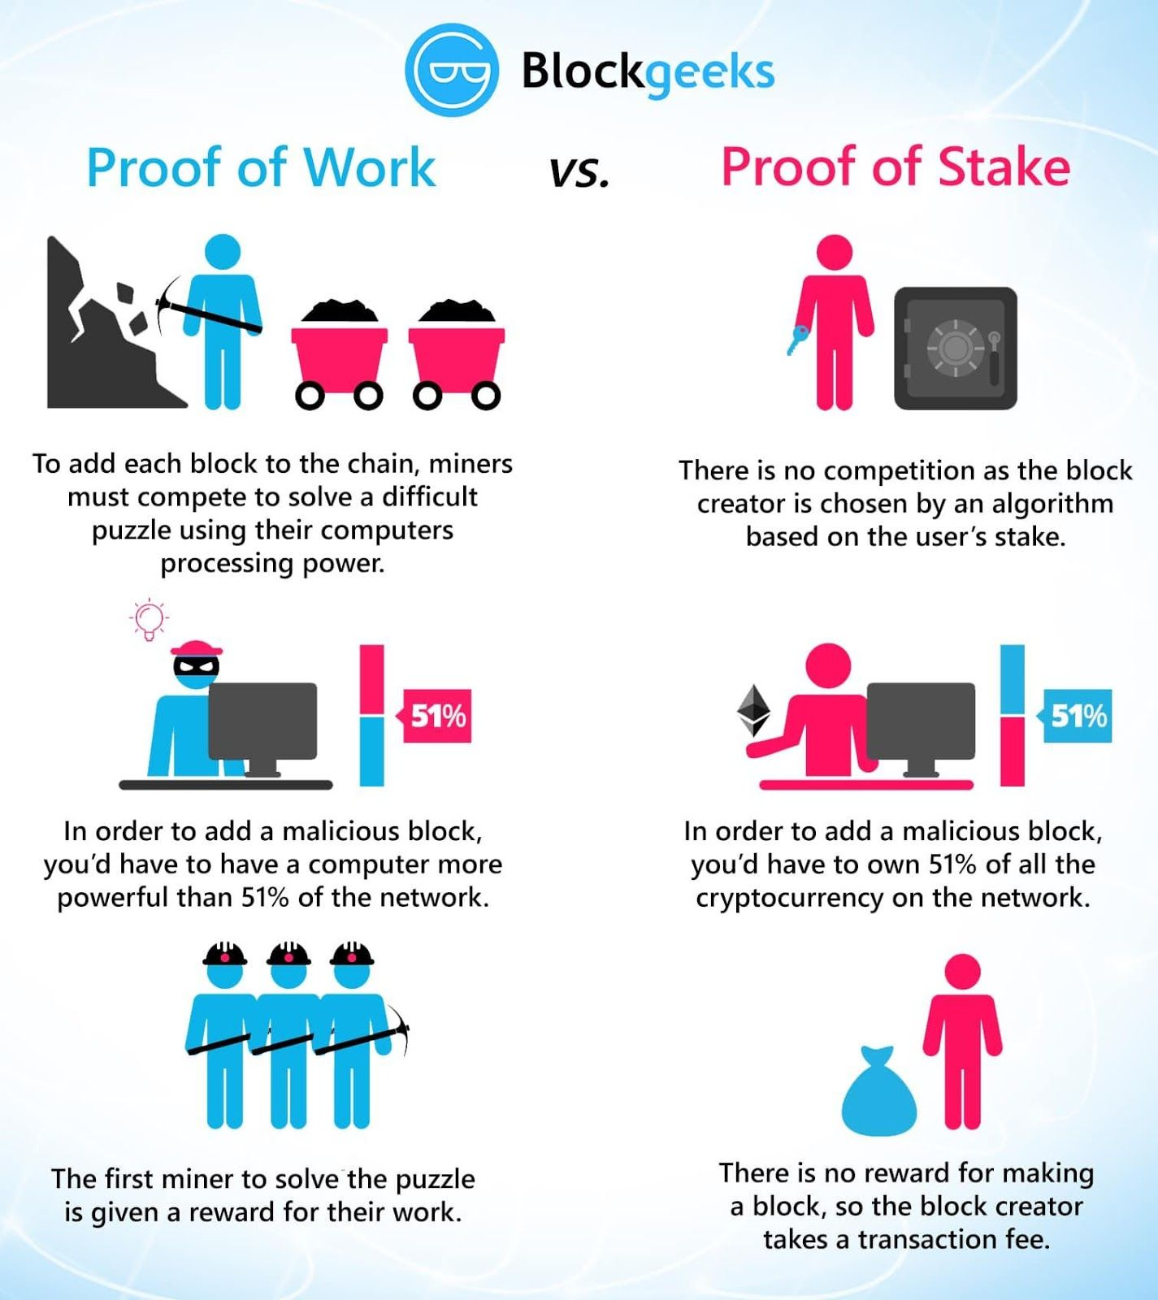
Proof of Work vs Proof of Stake

Slide 15
Simulation
I’ve created smart contract with solidity called Election.sol . Used truffle.js to compile and migrate it to the local blockchain created using ganache tool. The output of contracts compilation is a JSON file. Which is used by truffle.js to interact with the blockchain.
Ganache by default generates 10 accounts with fake ether. To interact with the blockchain.
The genesis block is created with the candidates (4) with 0 votes initially. Only one per-
son/account is allowed to vote once. If a vote is casted using that account then the logged in can’t see the vote button and vote again.Web3 is used to get the accounts from blockchain. Only blockchain’s connected accounts are allowed to vote.
There is a pie.js file which generates a pie chart on the basis of current vote casted on the
blockchain from genesis to latest block.

Slide 16
For testing mocha framework is used. Total 5 test cases.
For 4 candidates.
For correct values( name and 0 votes)
For allowing a account to vote
Throwing exception for invalid candidate( >4)
Throwing exception for double voting.
The App.js contains a object with 5 vars and 7 functions along.
Currently the dapp is built using JavaScript, html5, bootstrap. Currently the dapp requires refresh automati- cally after the vote haven been casted.

Slide 17
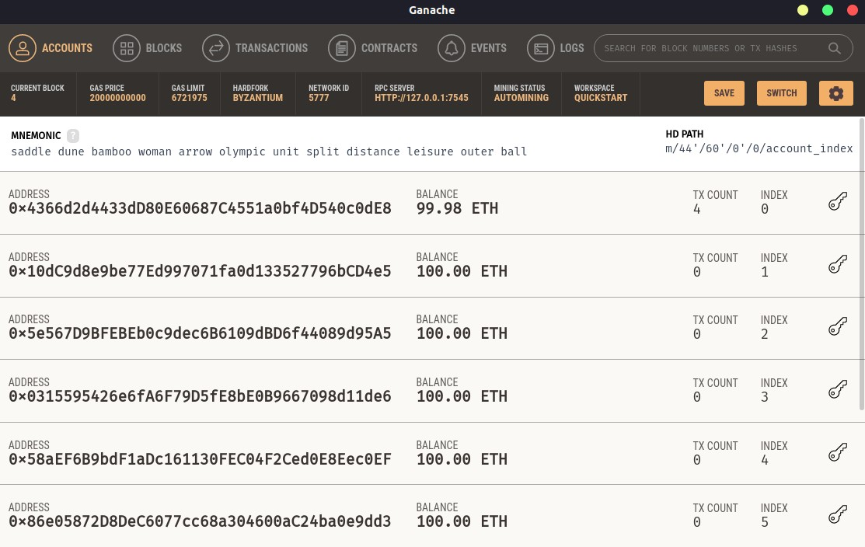
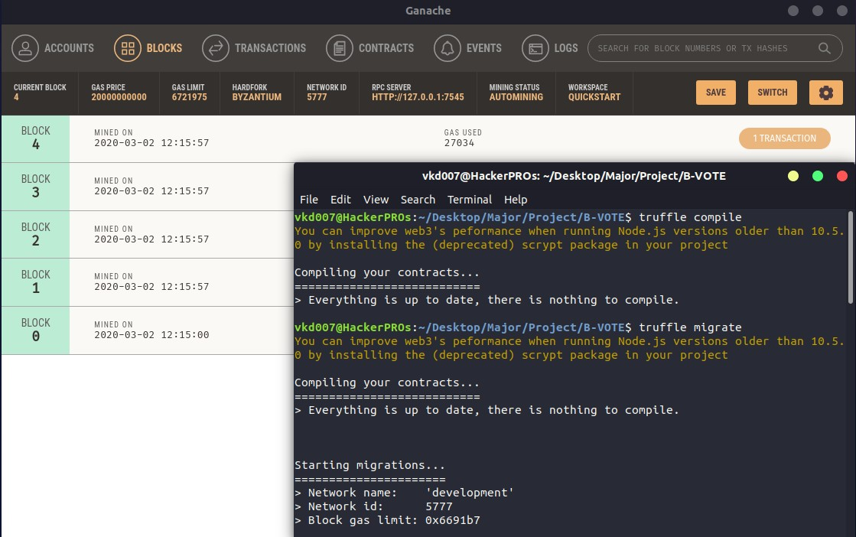
Screenshots
1. Initializing Ganache (Local blockchain tool) will generate accounts specified which in this case was 10.
2. Compiling and deploying smart contracts. The contract will be called and blockchain will come into existence with a genesis block.

Slide 18
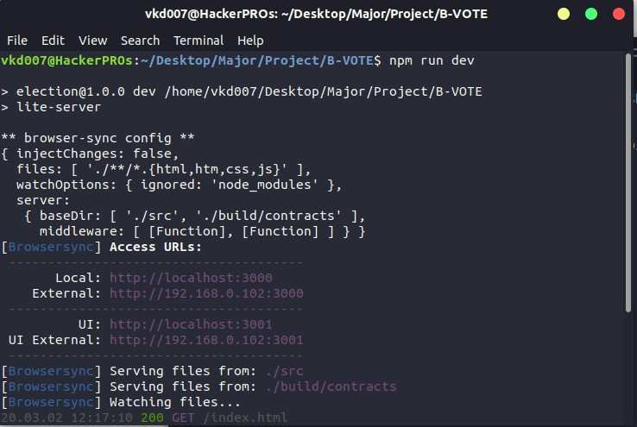
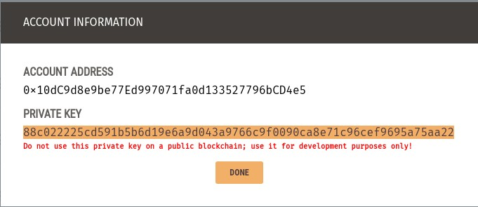
3. Hosting the dapp on the localhost using lite-server along with browser sync module.
4. Copying the private key of one of the accounts from ganache.

Slide 19
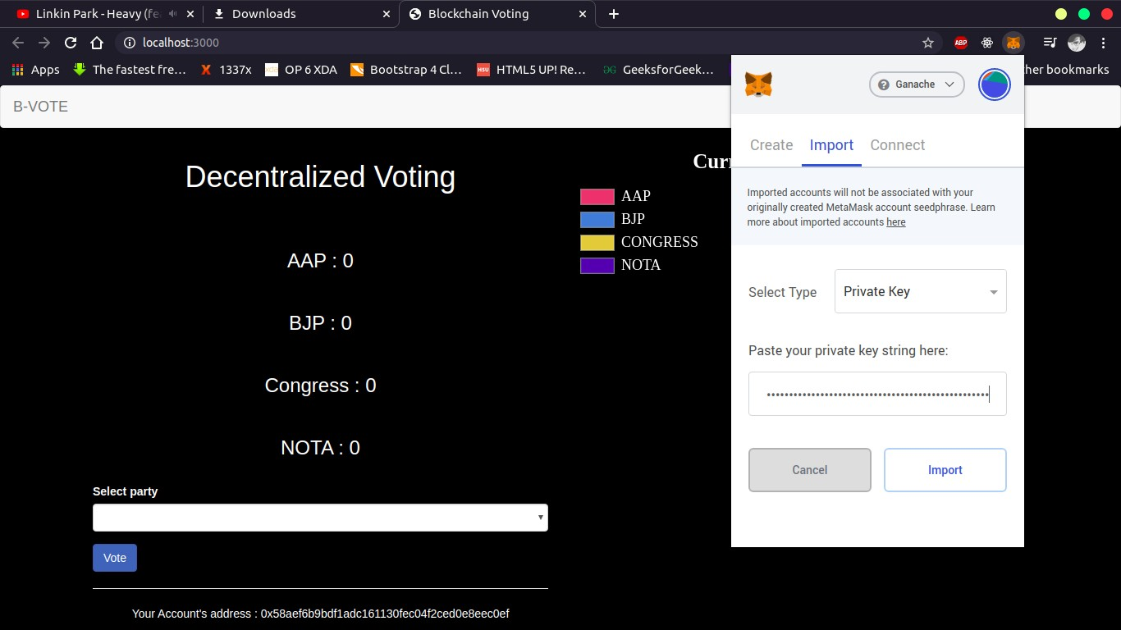
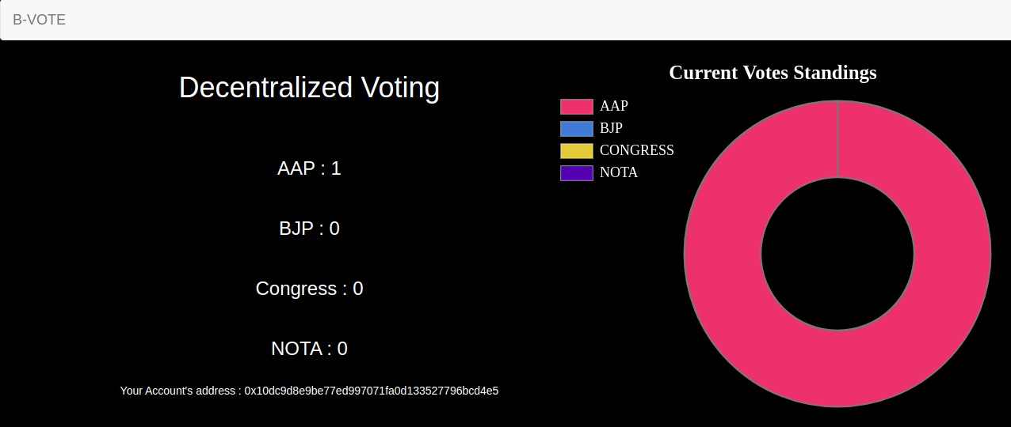
5. Inserting the private key into the metamask extension which connects the blockchain to the browser.
6. After voting using the account imported the vote button hides and the pie chart is displayed with the current standings.

Slide 20
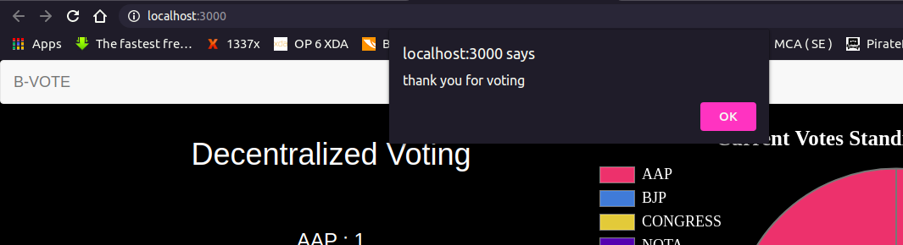
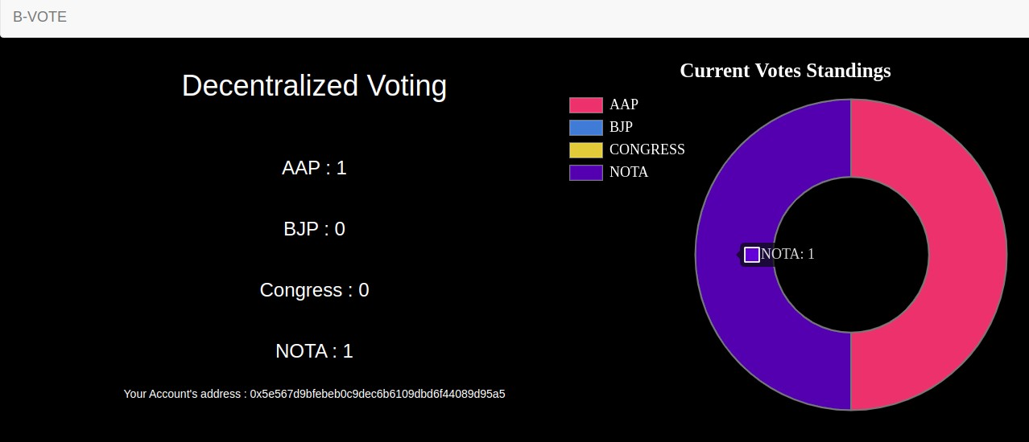
7. This alert pops up after you successfully vote for a party. If there’s a popup that means the vote has been cast successfully.
8. After voting once again the vote button hides itself and pie chart updates on refresh. The pie chart shows the current votes which the respective parties got.

Slide 21
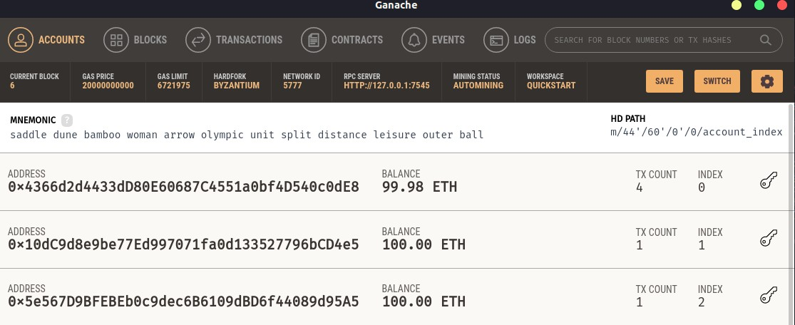
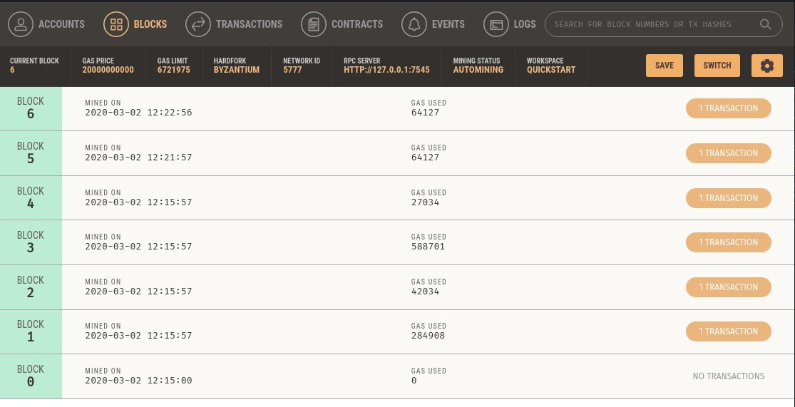
9. The initial blockchain without a transaction from the dapp was 4 blocks but after voting twice the blocksize increased with 2 more blocks.
10. You can see the blocks in ganache tool the date and time of the new block creation.

Slide 22
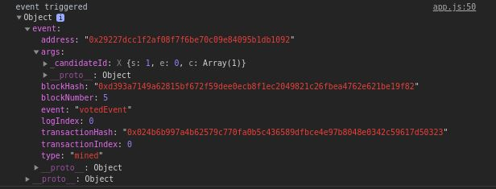

Analysis of Transactions
Whenever a person click on the vote button he is able to vote and if the transaction is successful then block hash and transaction hash are generated.This Screenshot is from the browser. object stores all the information about the transaction.It also shows the even which happened (votedEvent) which is a function in the codebase.
This Screenshot is from the Ganache Local blockchain tool. Here we can only see the amount
of gas used and the no of block and transaction hash.

Slide 23
Limitations
Blockchains are immutable. Chances of human error in data is huge so when a person makes a mistake it will be stored forever. At the current state of blockchain the development is quite difficult as it is still a growing industry. There are few open source libraries but they lack in functions. For which you would have to include another library. Also blockchain requires a block network which is easily available for localhost via Ganache or Ganache CLI but to publish it on the web its quite difficult.
Since blockchains are transparent its data is visible to all users. So if your Access is the biggest thing in a system to play with functionality and that here has limited the game altogether!
Also, blockchain systems require more resources than the traditional system. Since the ledgers of all the nodes are to be updated after every transitions.

Slide 24
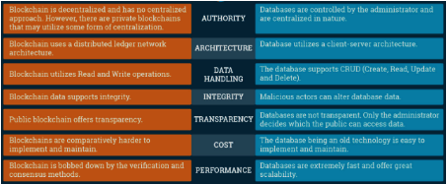
Comparison to Traditional System
Both of the systems have their caveats and advantages but the blockchain system beats the traditional one(DB) in terms of security and transparency. Since after voting for a candidatei n a traditional system you aren’t 100% sure that he/she received it but in case of blockchain based voting app it's visible and non editable so once a vote is granted it can’t be changed.Every other node can see the ledger or the (information) of other block that is why it is transparent. Consensus methods are used to verify the transactions like POW and POS.

Slide 25
Conclusion
The idea of adapting blockchain voting system to make public elections cheaper, faster and secure is compelling in this advance era. Its not only better and efficient than the EVMS but also more reliable and secure. It is not possible for any account to vote without any ether in that account and are not mined on that blockchain. So, it is safe to say that no external entity can vote. To make changes to the blockchain the external entity must hold all the nodes in physical possession and do 51% attack which is impossible if we have 100+ nodes. So with Aadhar Api the project will be fully ready for deployment and can be tested so that it
can be used for future elections.

Slide 26
Future Scope
The current scenario is the blockchain transactions require mining (which is costly). If a user wants to do a transaction it requires to have some coins or Ethereum[1] in my case. Without it it’s not possible to vote. And there are no blockchain platform available for mobile devices.
So, REST api[11] can be made so that it can be ported to mobile apps and users can cast vote from mobile. Also, a foolproof way to validate user is required. I was hoping to integrate
Aadhaar api in the project but the govt still haven’t replied me. So, the project just needs Adhaar api or Voter Id api to create user and provide them with some coins to cast the vote.
Also the Web App should be deployed on the cloud as the no of users increases the system will require more CPU and memory. AWS or GCP [12] are the best possible options present
,as both supports auto scaling and different types of cpu and os .Currently the system requires unix based os to run but it can also use windows platform with few minor tweaks.

Slide 27
References
https://ethereum.org/
Blockchain: Blueprint for a new economy (February 2015) ISBN : 978-1-491-92049- 7
https://www.youtube.com/watch?v=32F3X1E121A
https://eci.gov.in/evm/
https://www.udacity.com/course/blockchain-developer-nanodegree–nd1309
https://www.academia.edu/11766757/Comparative_Study_of_Various_SDLC_Model s_on_Different_Parameters
Performance Characterization of Hyperledger Fabric (CVCBT 2018)
https://www.uidai.gov.in/914-developer-section.html
https://www.quora.com/How-much-approximately-does-an-electronic-voting- machine-EVM-cost-Do-we-import-them-or-do-we-make-them-in-India
https://solidity.readthedocs.io/en/v0.6.7/
Analysis of REST API Implementation (ISSN : 2456-3307)
Comparative Study of Cloud Services Offered by Amazon, Microsoft & Google (2456- 6470)
Nicholas Weaver (2016). Secure the Vote Today.
https://www.lawfareblog.com/secure-vote-today
14. https://blockgeeks.com/guides/proof-of-work-vs-proof-of-stake/
15. https://101blockchains.com/blockchain-vs-database-the-difference

Slide 28
END

